Slide 1
Coffee Sales Insights
A Data-Driven Exploration
Queens Café

Slide 2
WIT-Business Analytics
Student
Maryam Maksour
Sumaia Al-aqrabi
Rusaima AL Zahrawi
Shahama Mohamed
Tutor
Mentor
Rami Alkhateeb
Rana Rabbad

Slide 3
Introduction
The secret ingredient behind countless bright ideas

Slide 4
COFFEE
The magical potion that turns 'leave me alone' into 'let's do this!
coffee has been the lifeblood of countless mornings and late-night deadlines

Slide 5
COFFEE
In this project, we’re brewing up some data magic, exploring coffee orders to uncover what gets people buzzing .
Whether it’s bold Robusta, smooth Arabica, or the mysterious Excelsa , we’re diving deep into roast levels , cup sizes , and customer quirks.

Slide 6
Table of contents
Grab a cup and join us as
we spill the beans on coffee trends and habits!

Slide 7
OUR DATA
The secret ingredient behind countless bright ideas

Slide 8
Products sheet
Our analysis comes from three key data sets:
Orders sheet
Customers sheet
Gives us all the details about sales, like when orders were placed, how much was sold, and the revenue we made—perfect for spotting trends.
Helps us get to know our customer base better, with info like who they are and how to reach them, so we can market smarter.
The tells us about the items we sell, like their categories, descriptions, and prices, helping us see what’s working and where to improve.

Slide 9
These three sets of data really drive our insights!
To analyze how price changes impact profit volumes and to identify optimal pricing strategies.
To analyze the sales trends over time to identify peak periods and seasonal variations in coffee sales.

Slide 10


How do changes in pricing affect the volume of coffee profit and what price points maximize revenue?
The Power Of Pricing

Slide 11

In general: The high net profit is not necessarily related to the high price of an item. Sometimes, we sell certain products at no profit. These products are simply meant to attract customers and encourage them to purchase other items that have a higher profit margin. In this project, we will study whether the profit is related to the price at the Queens' Café.

Slide 12
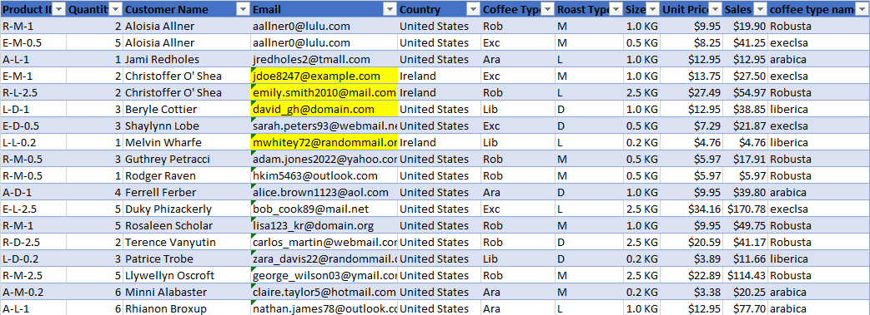
Data cleansing
The data was clean
No wrong numerical values
No incorrect names
Blank emails
We created moch emails to fill the gab.

Slide 13
Let's go deep in our data

Slide 14
The best customer
Personal data
Name: | Allis Wilmare
Gender: | Female
Country | United States
City | Houston
Seles | $317.07

Slide 15
2,799$
The sum of sales for each country
From 2019 - 2021
That means we need to create a new marketing plan for the United Kingdom and Ireland.
United Kingdom is the least selling
35,639$
United States is the best selling

Slide 16
Loyalty card

Slide 17
percentage of order in each country

Slide 18
Sales for each coffee type
Profit for each coffee type
27%
27%
26%
20%
22%
28%
33%
17%

Slide 19
Sales during years
2019
2020
2021

Slide 20
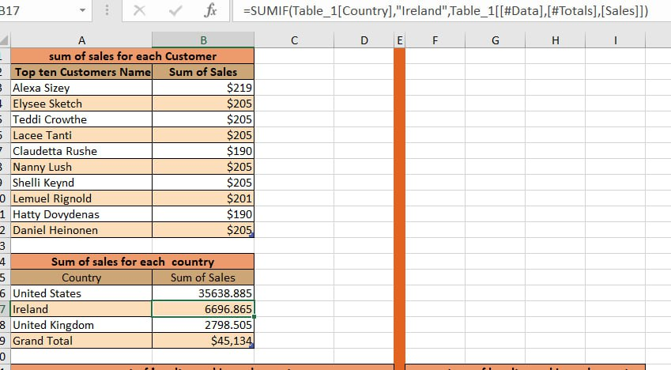
We did some formulas

Slide 21
The price of success
A deep drive into coffee profitability.

Slide 22
Linear Regression
A linear relationship between two variables
Equation
y = 0.1108x + 0.44
x: This is the independent variable (unit price).
y: This is the dependent variable (profit).

Slide 23
OUR Result
Regression Statistics
Multiple R | 0.903169969
Regression Statistics
Multiple R | 0.903169969
R Square | 0.815715992
Adjusted R Square | 0.814941689
Standard Error | 0.521451802
Observations | 240
A value closer to 1 signifies a stronger positive relationship.

Slide 24
"F-statics ↑ P-value ↓"
ANOVA
Coefficients
 | P- value
Profit Y | 5.24961E-13
Price | 2.23897E-89
F-statistic | Significance F
1053.484826 | 2.239E-89
The high F-statistic and the extremely low p-value
indicate that the overall regression model is statistically significant

Slide 25
The power of price
2
The model is statistically significant
1
3
The regression output suggests a strong and positive relationship between the independent variable (X) Unit price and the dependent variable (Y) Profit
The positive slope indicates that as X increases, Y also increases.

Slide 26
Conclusion And Recommendations
In conclusion, our analysis of Queens Café's coffee sales provides valuable insights into customer behavior, product performance, and pricing strategies.
Based on our findings, we recommend:
Implementing loyalty programs in low-performing regions like the UK.
Focusing on high-margin coffee types, especially Arabica.
Refining pricing strategies to balance volume and profit.

Slide 27

The Future Of Coffee Sales Is Data-Driven
Thank you for your time and attention.

